Slide 1
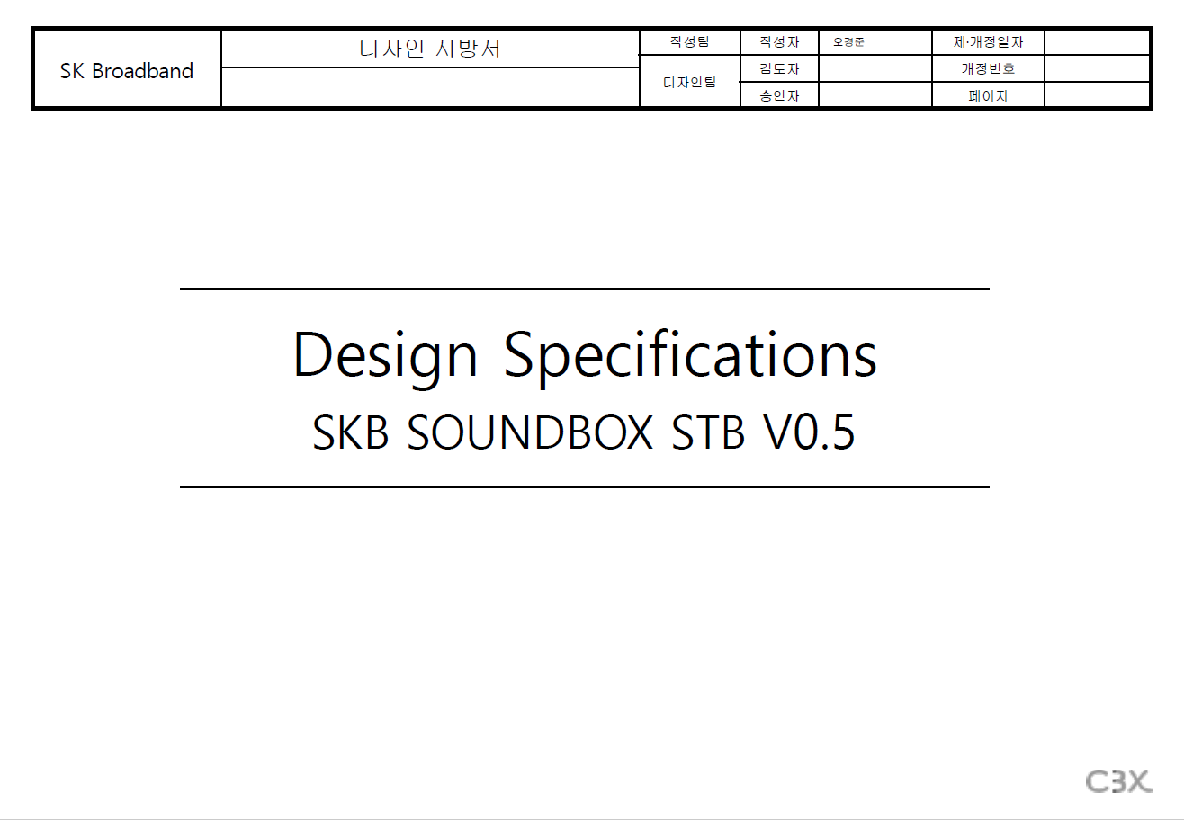

Slide 2
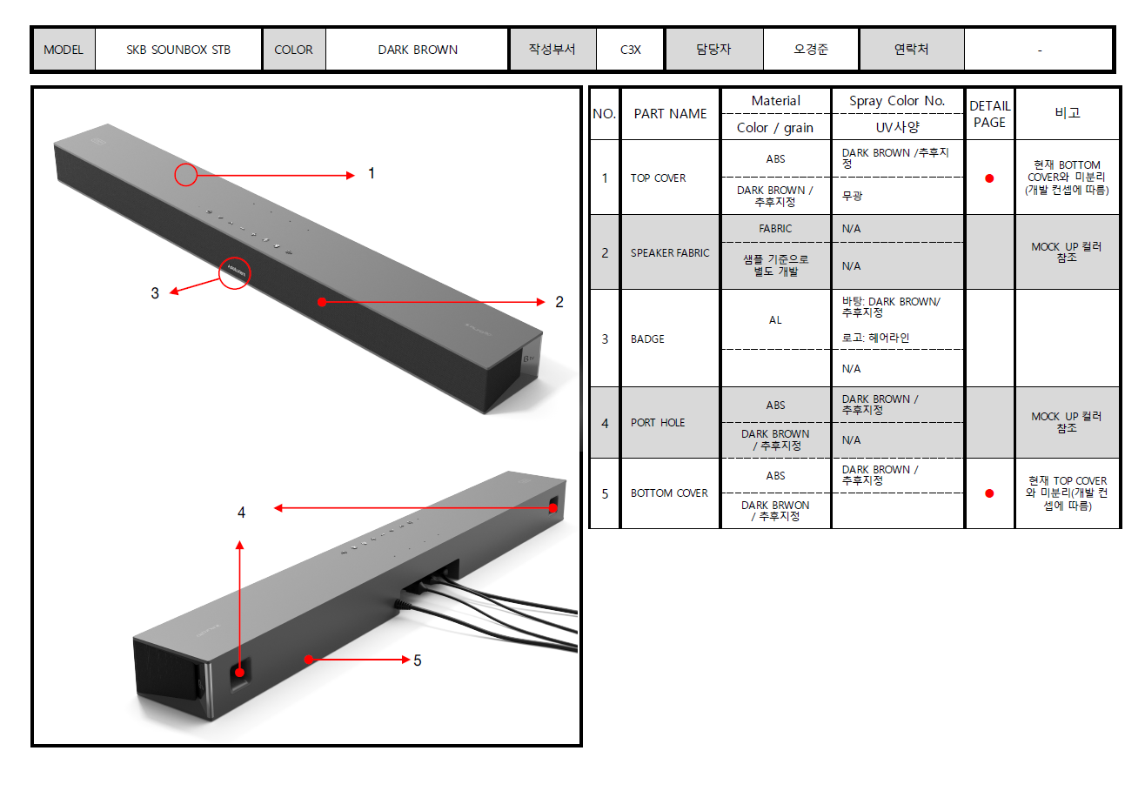
a
c
b
d
e
f
a
g
a
a
c
a
DARK BROWN / T.B.D
Matte
As of: Not separated from BOTTOM COVER (It follows the development concept)
Developed separately based on samples
Bottom : DARK BROWN / T.B.D
Logo : Hairline
Refer to the Mock-up color

Slide 3
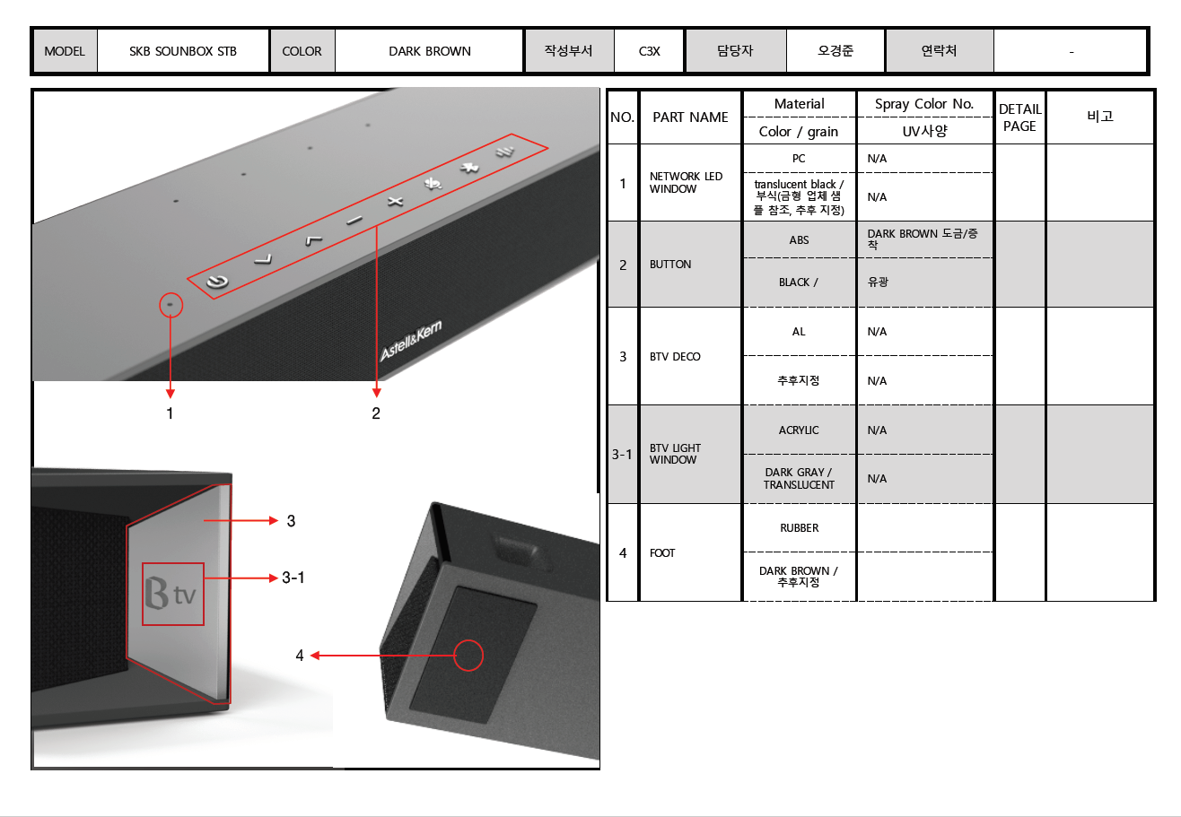
a
b
c
d
e
translucent black / Texture (Refer to the sample of the mold maker, T.B.D)
DARK BROWN Plating / Metalizing
Glossy
T.B.D.
DARK BROWN / T.B.D

Slide 4
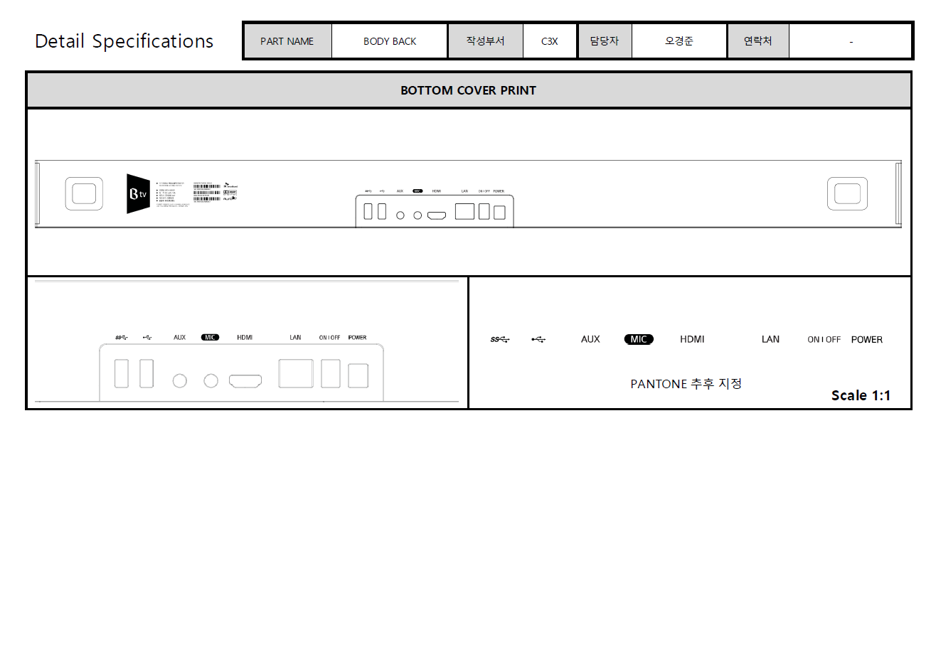
PANTONE : T.B.D

Slide 5
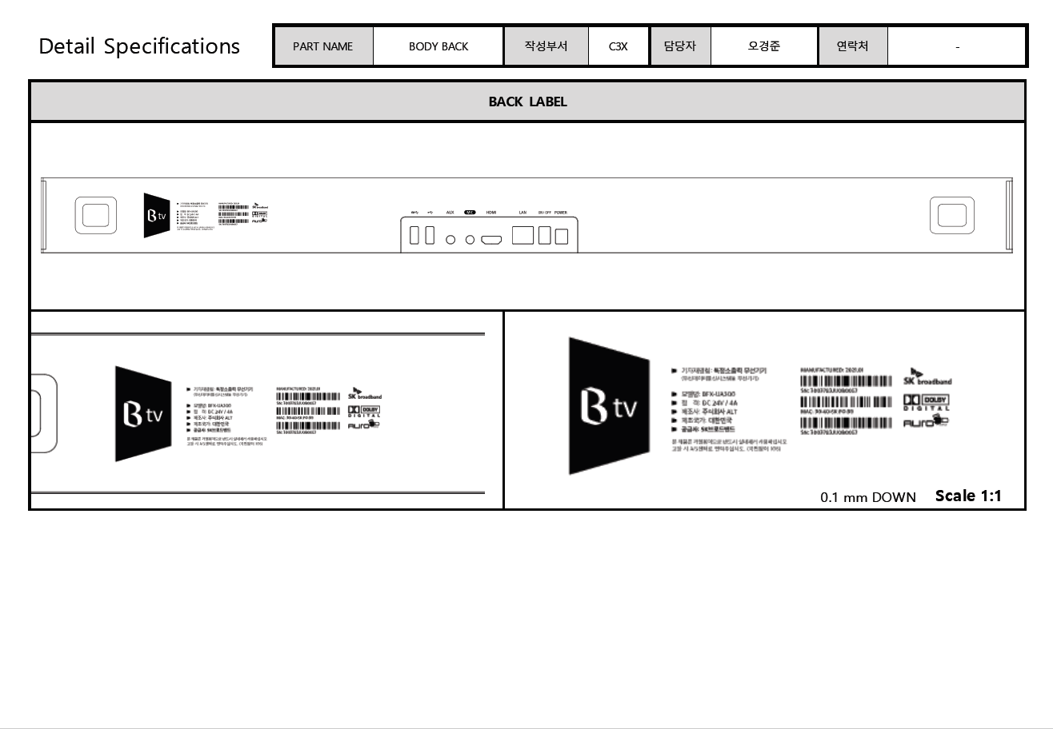
ALT_20200629 : ALT will discuss with SKB that barcode silk printing is impossible

Slide 6
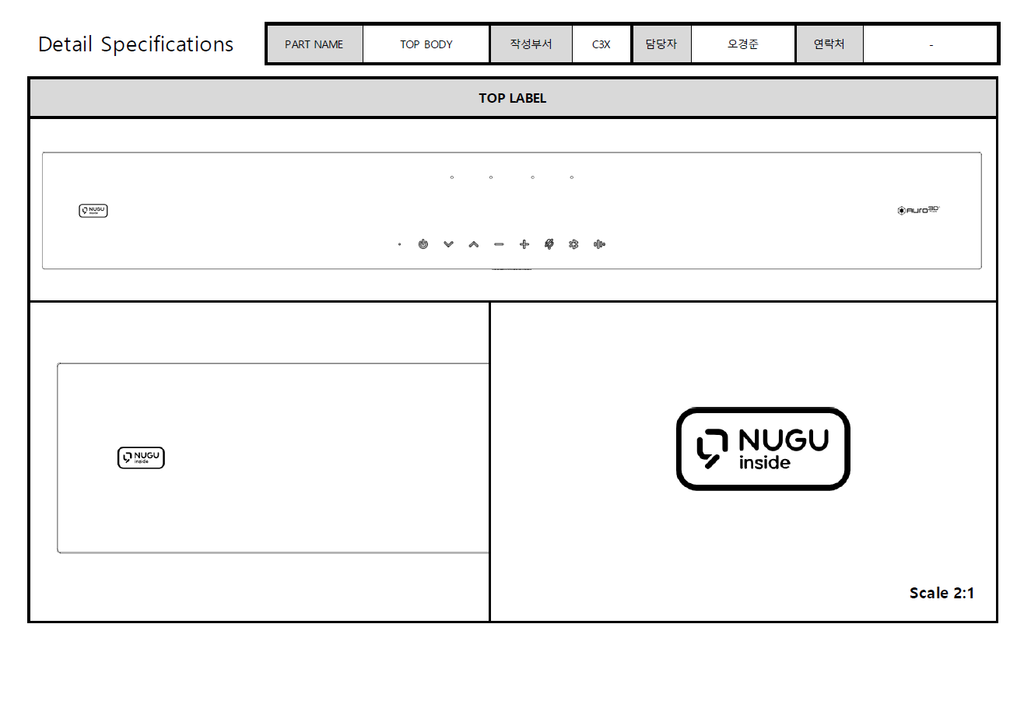

Slide 7
